Slide 1
Ionic Basis of Neuronal Excitability
Synapses & Circuits
Lecture One

Slide 2
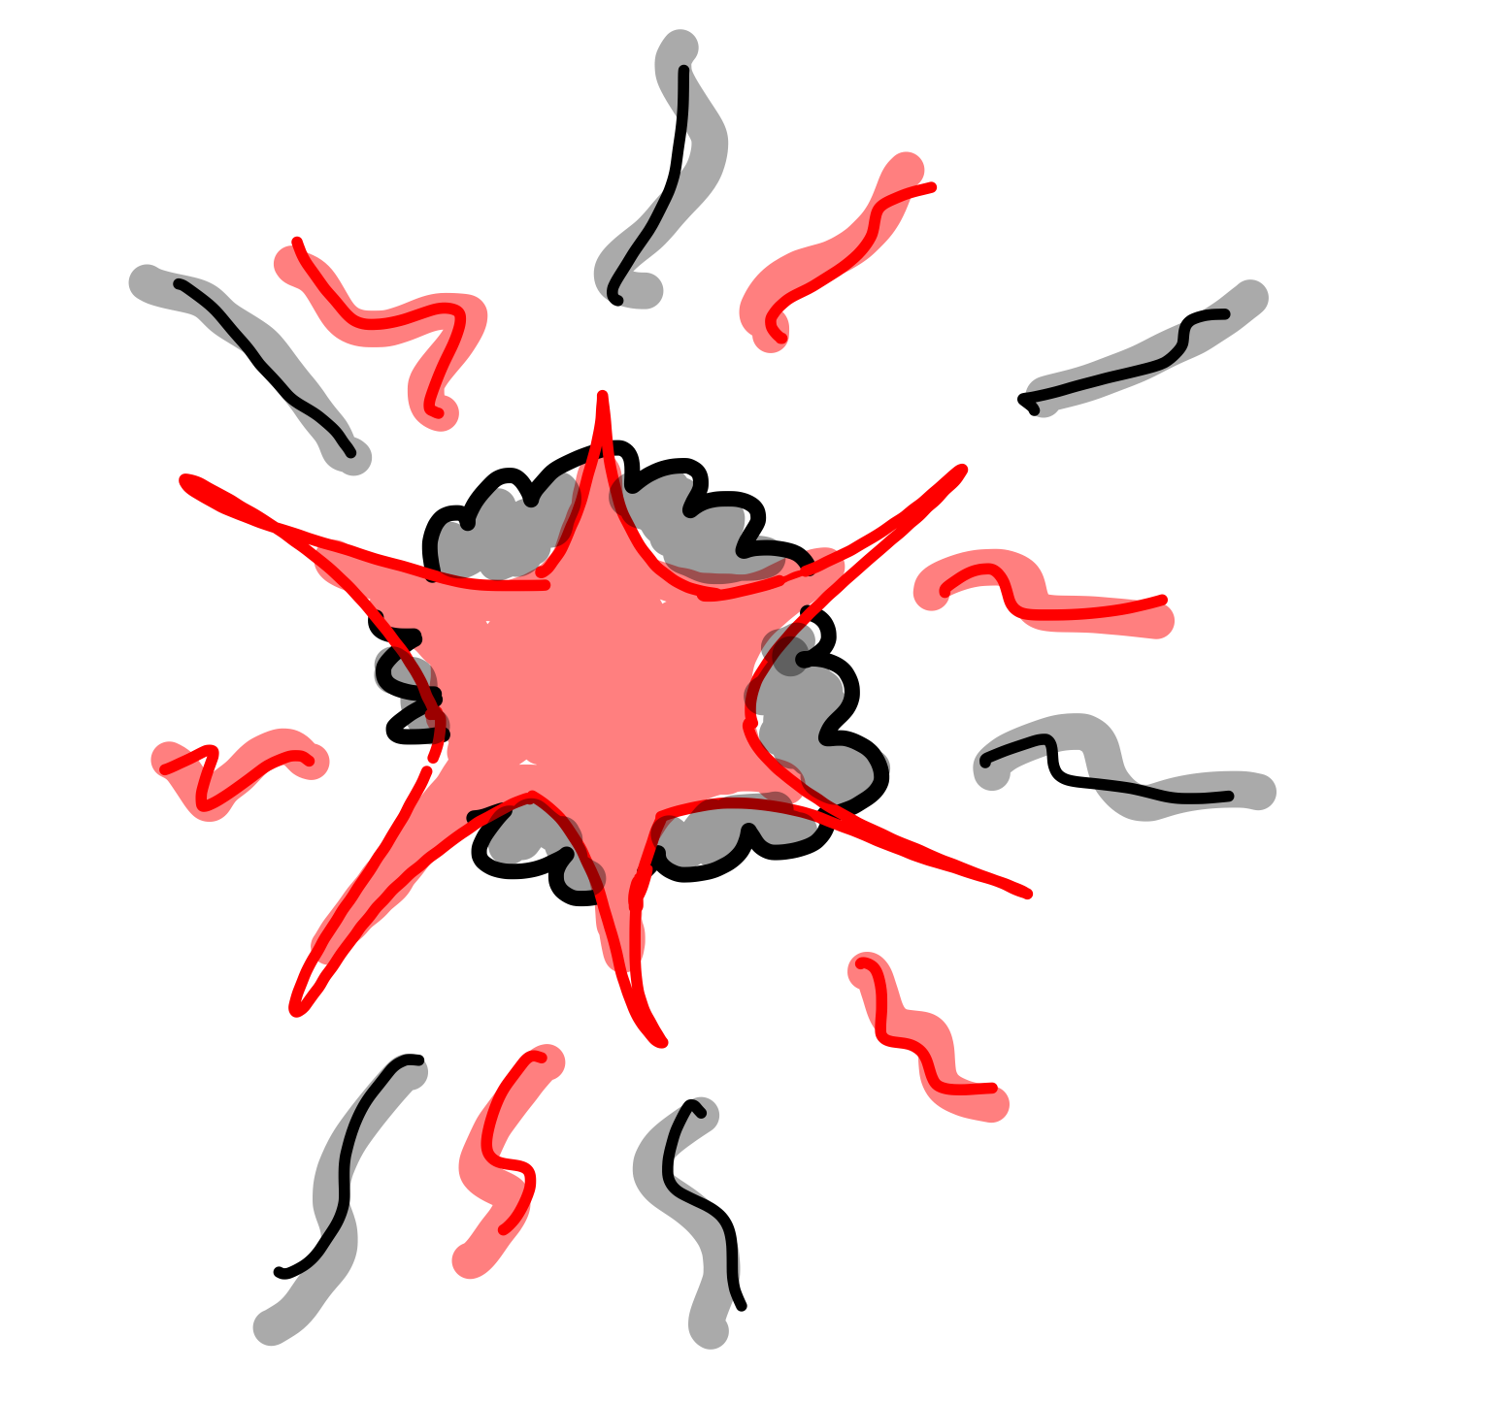

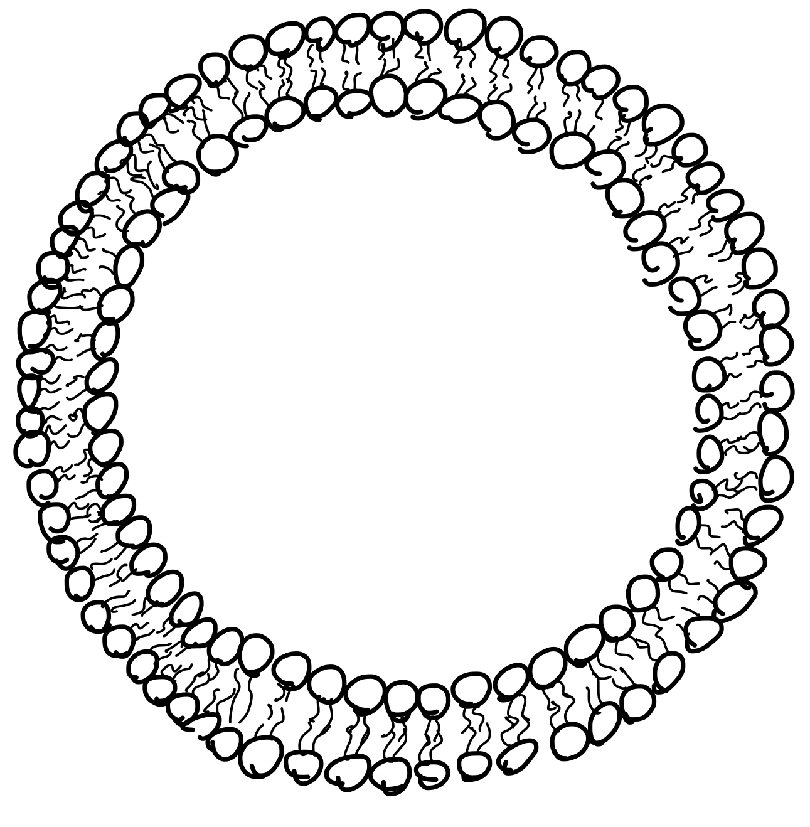




In the beginning…
A Big Bang
Earth
Cell
Channel

Slide 3

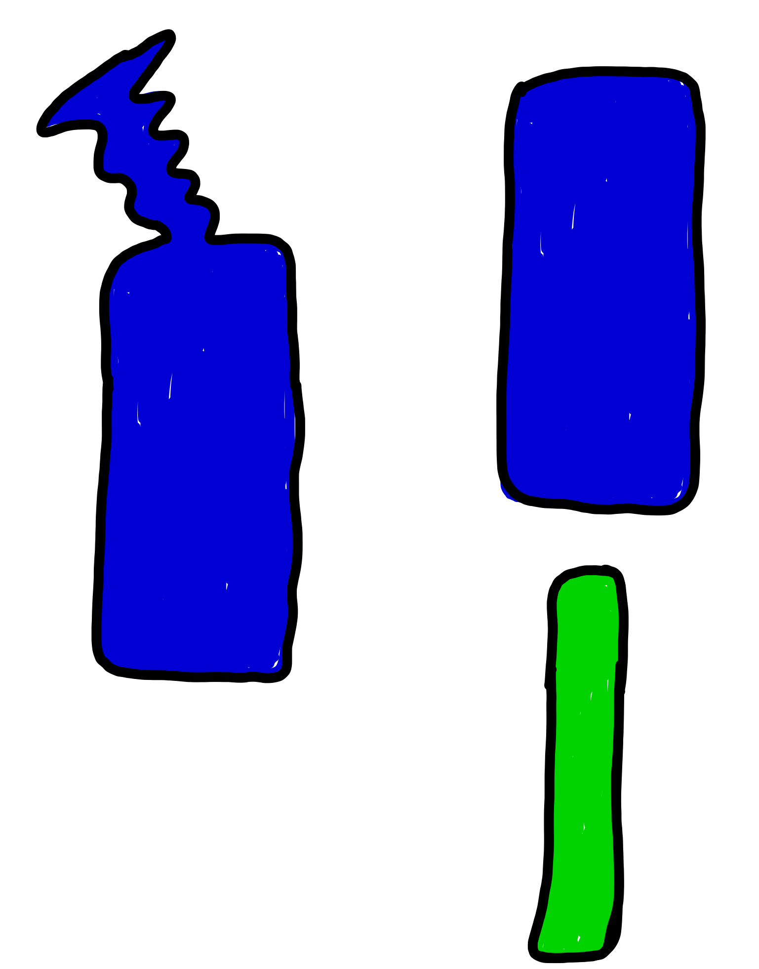
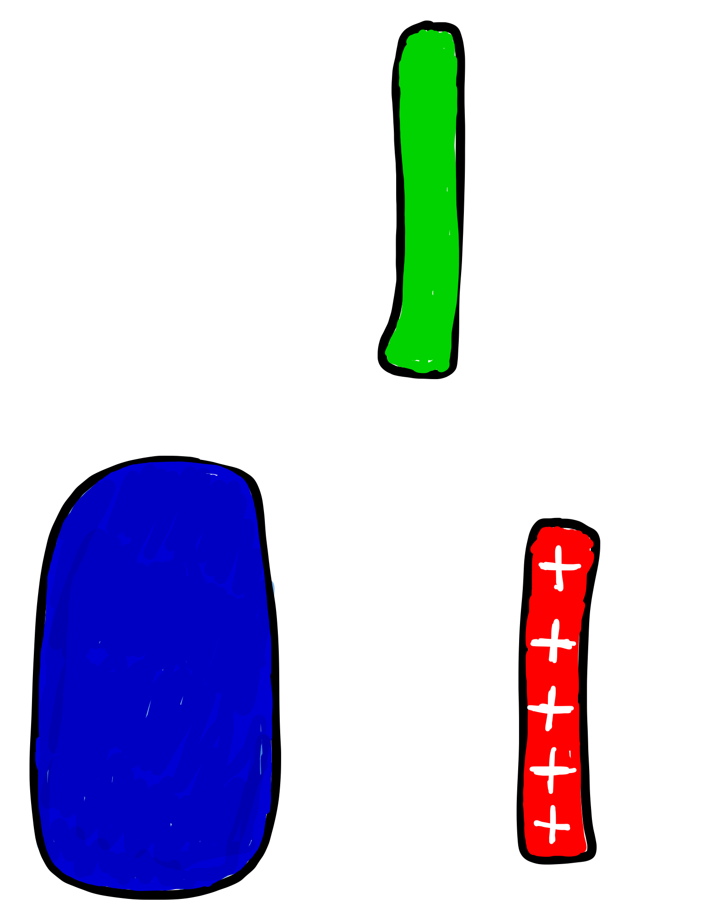
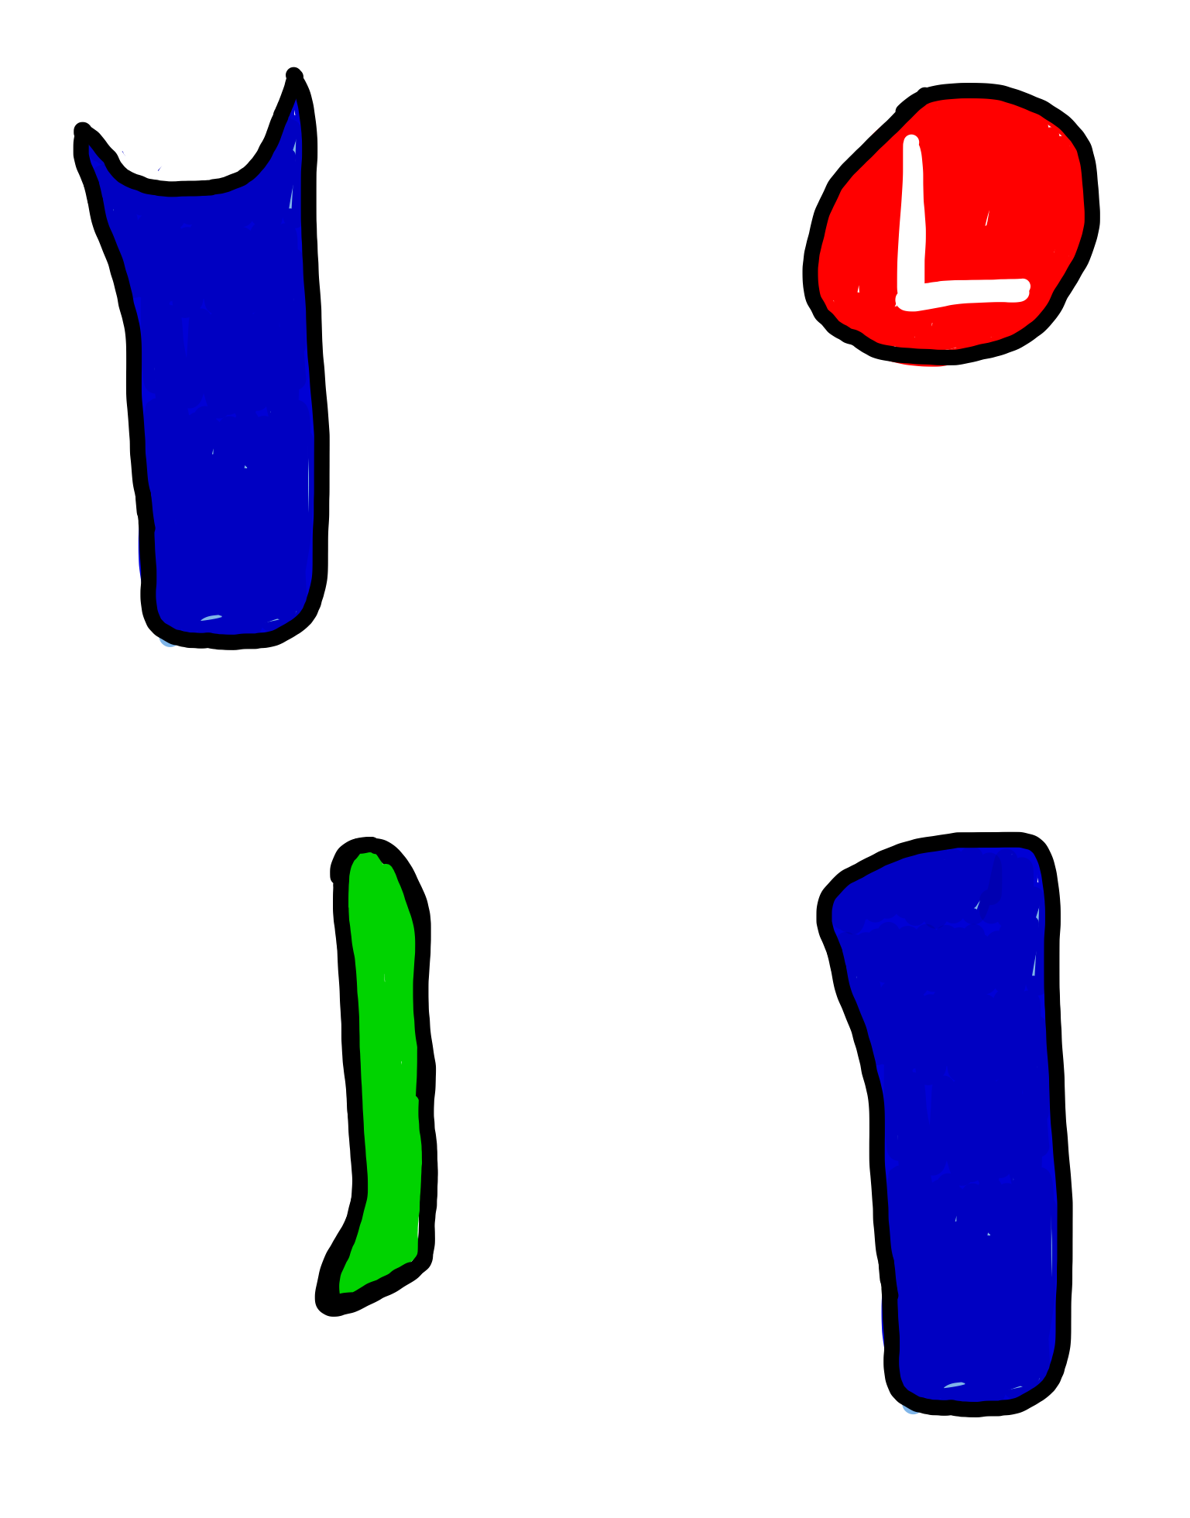
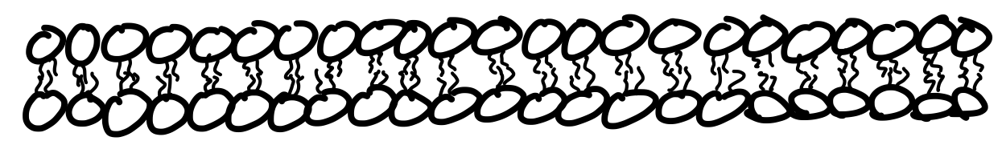
Ion Channel Gating
Voltage-Gated
Ligand-Gated
Mechanically-
Gated

Slide 4
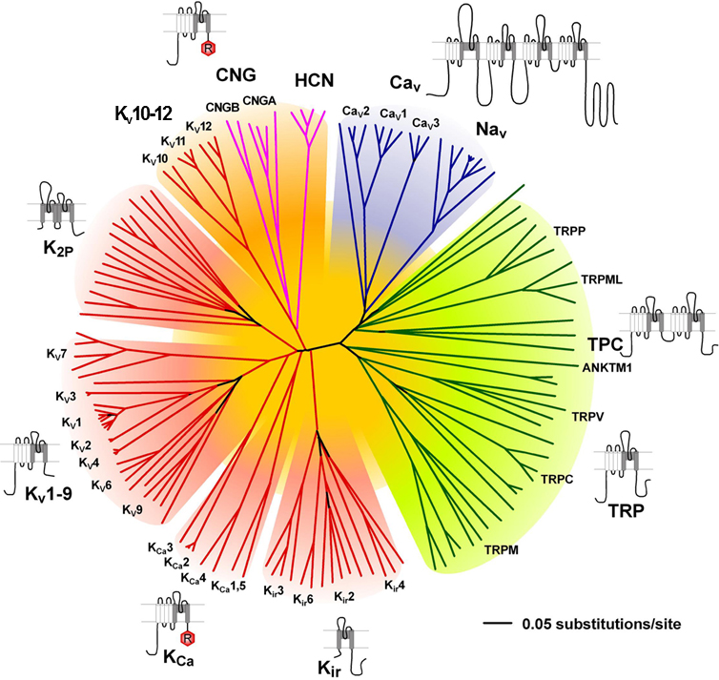
Ion Channel Diversity

Slide 5
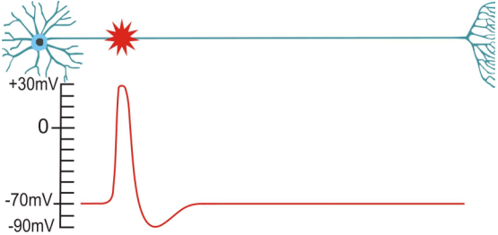
The Action Potential

Slide 6

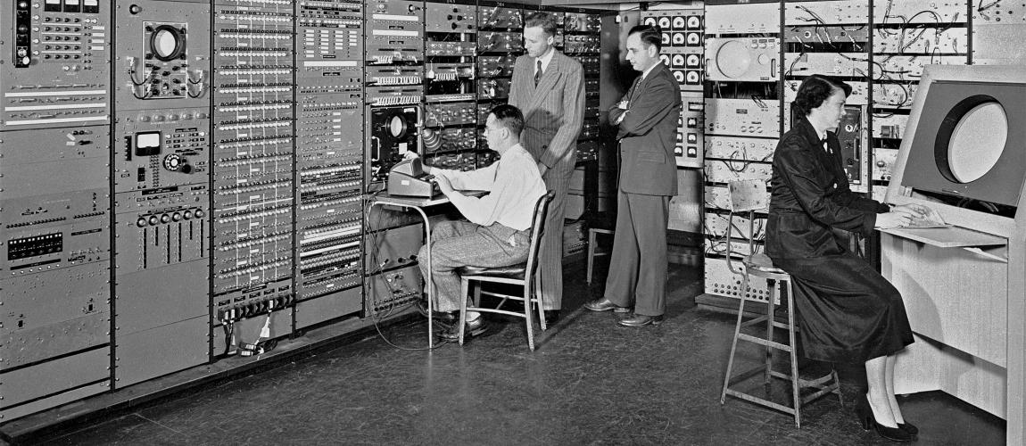


What happened in 1952
Average Cost of new house $9,050
Average wages per year $3,850
Cost of a gallon of Gas 20 cents

Slide 7

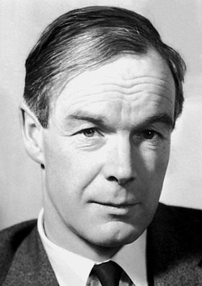
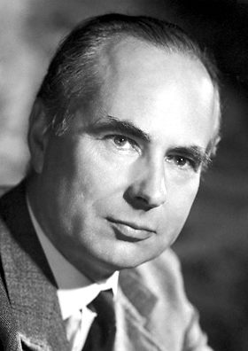
A Model for the Action Potential
Alan Lloyd Hodgkin
Andrew Fielding Huxley
HH

Slide 8
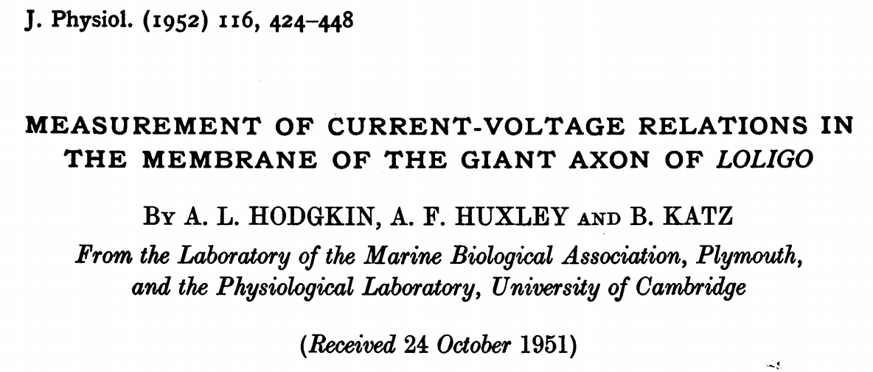
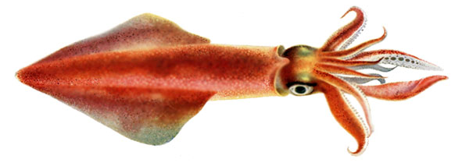

Slide 9
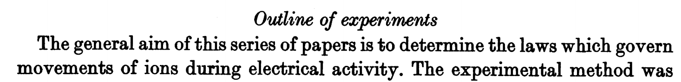

Slide 10
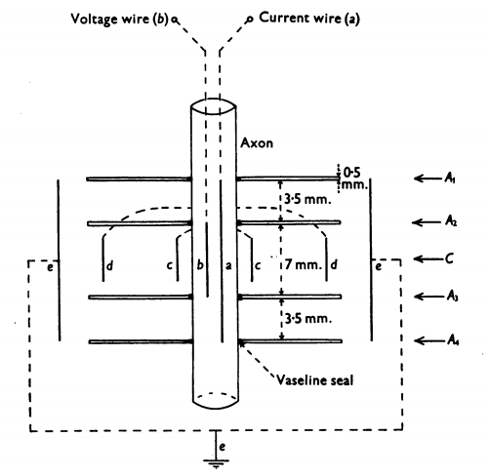
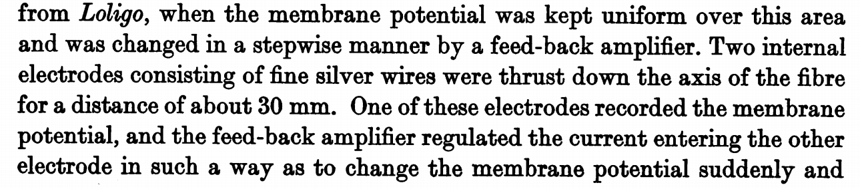
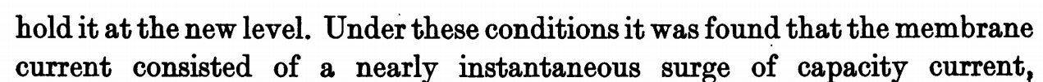

Slide 11
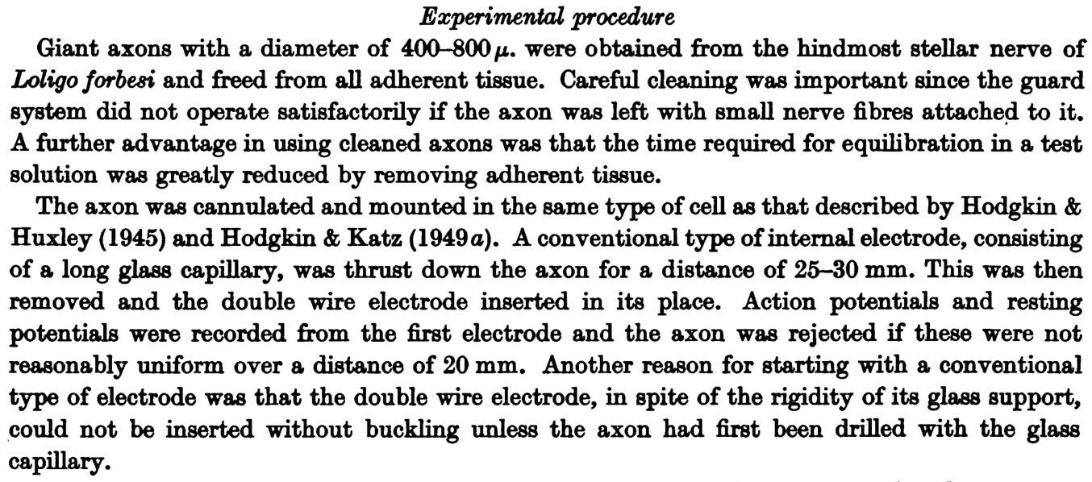

Slide 12
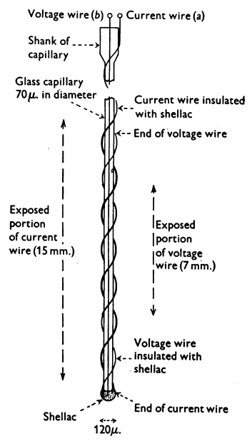
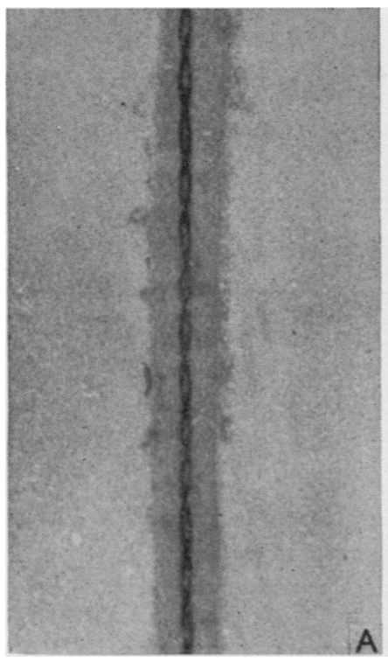

Slide 13
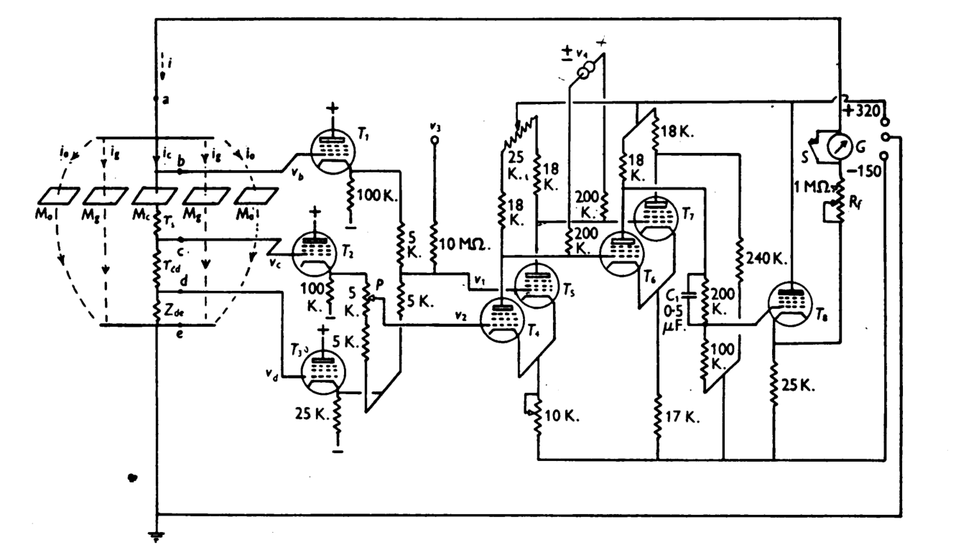
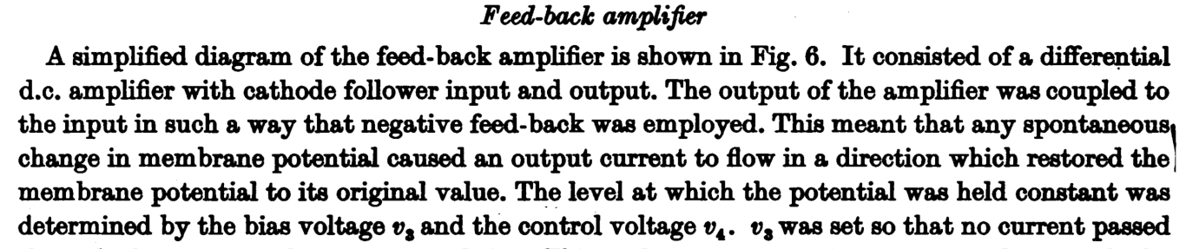

Slide 14
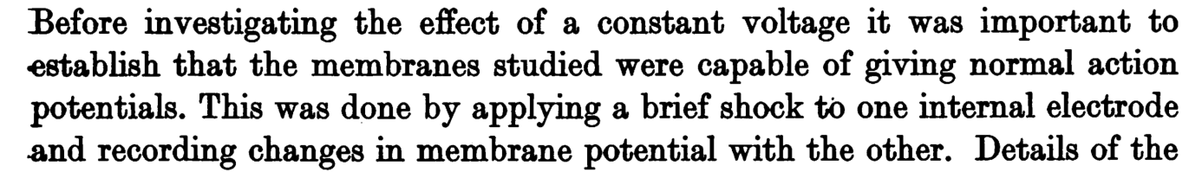
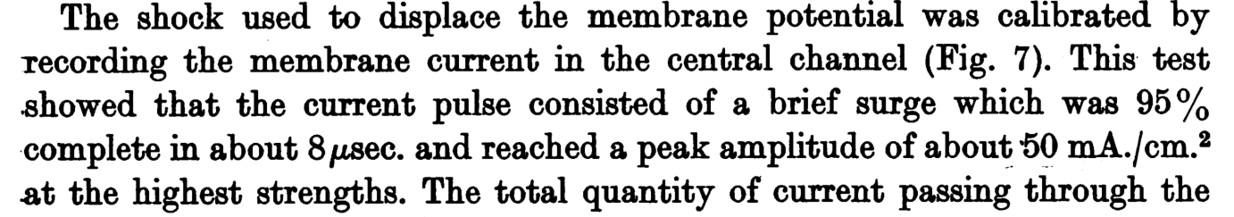

Slide 16
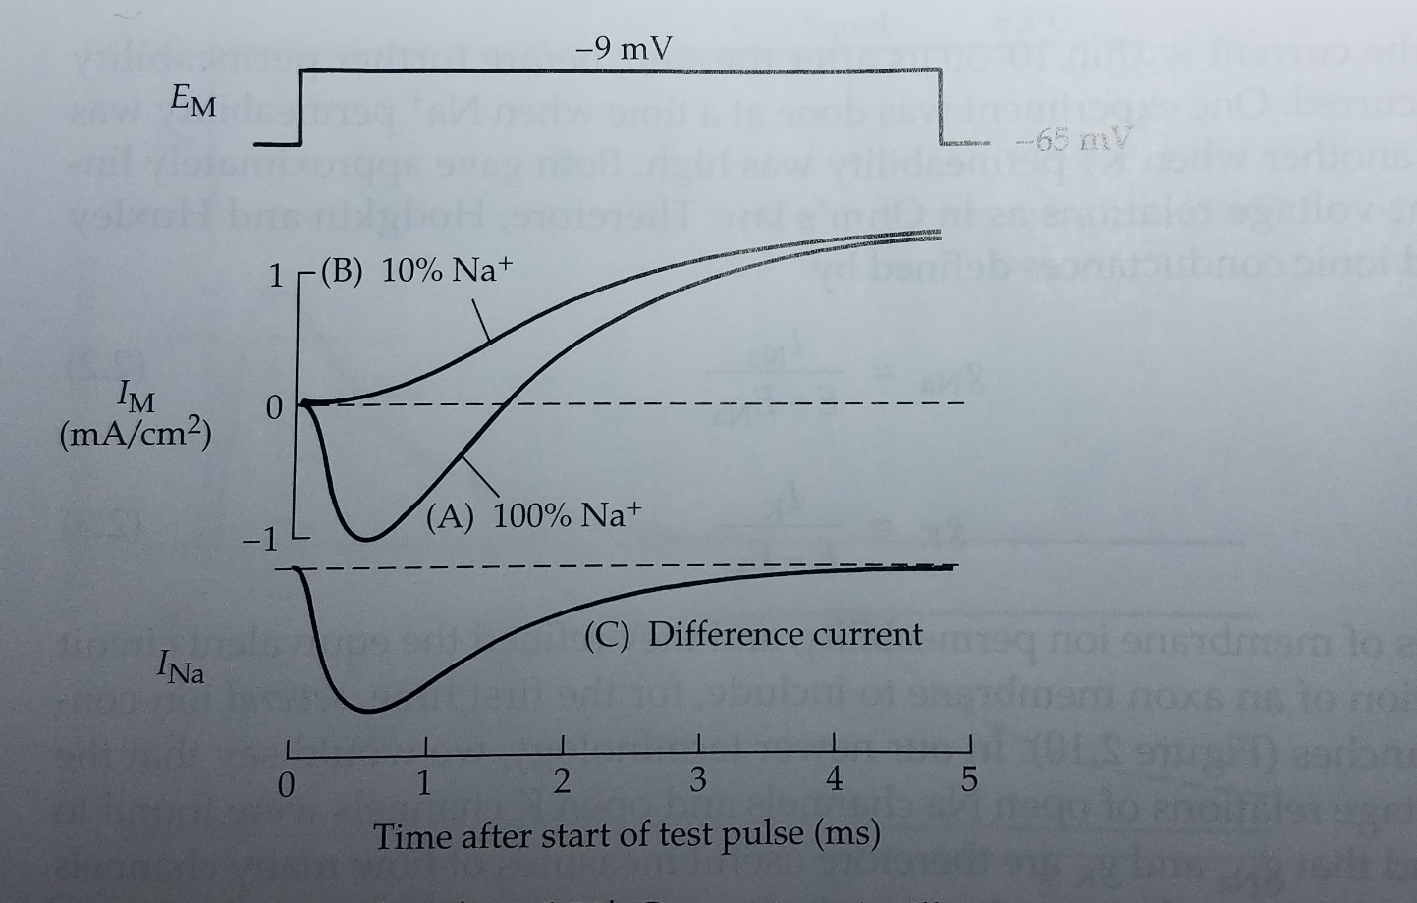
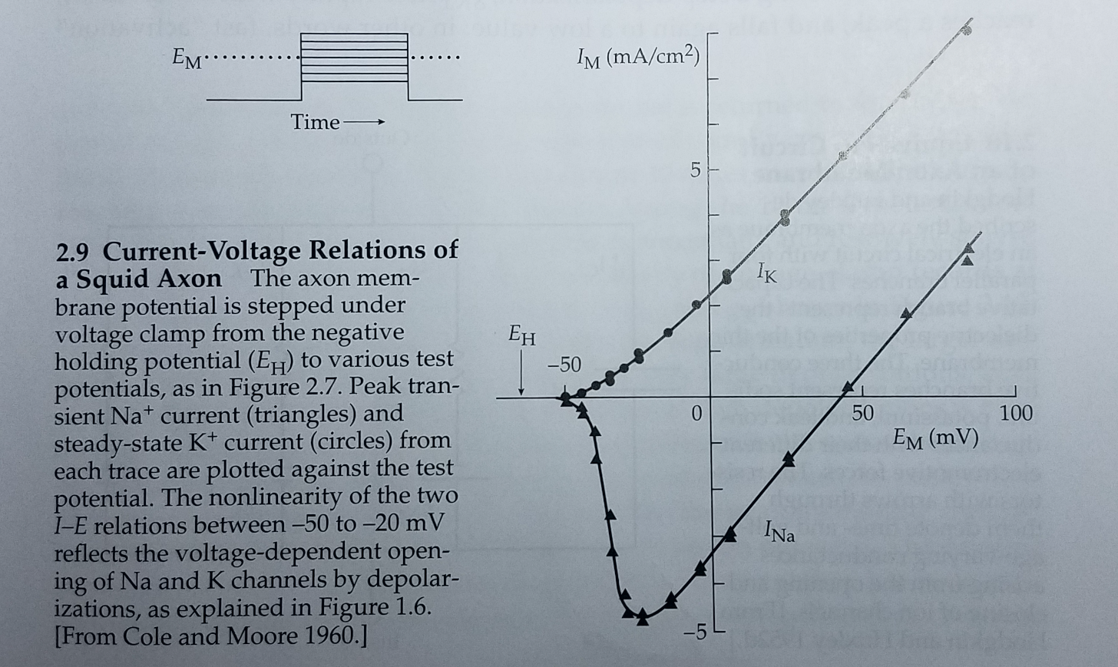
First of all….is the sodium current ohmic?
(everything is easier if it is)
V=IR
or I=V/R
or R=V/I
or 1/R=I/V
Ohmic?

Slide 17

First of all….is the sodium current ohmic?
(everything is easier if it is)
V=IR
or I=V/R
or R=V/I
or 1/R=I/V
VS
Ohmic?

Slide 18
First of all….is the sodium current ohmic?
(everything is easier if it is)
V=IR
or I=V/R
or R=V/I
or 1/R=I/V
Ohmic?

Slide 19
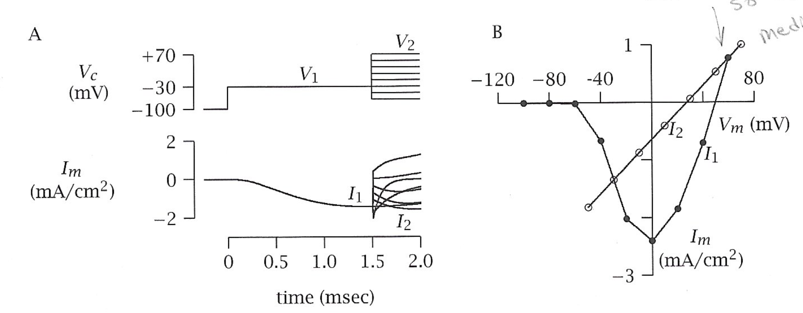
First of all….is the sodium current ohmic?
(everything is easier if it is)
V=IR
or I=V/R
or R=V/I
or 1/R=I/V
Ohmic!
Ohmic?

Slide 20
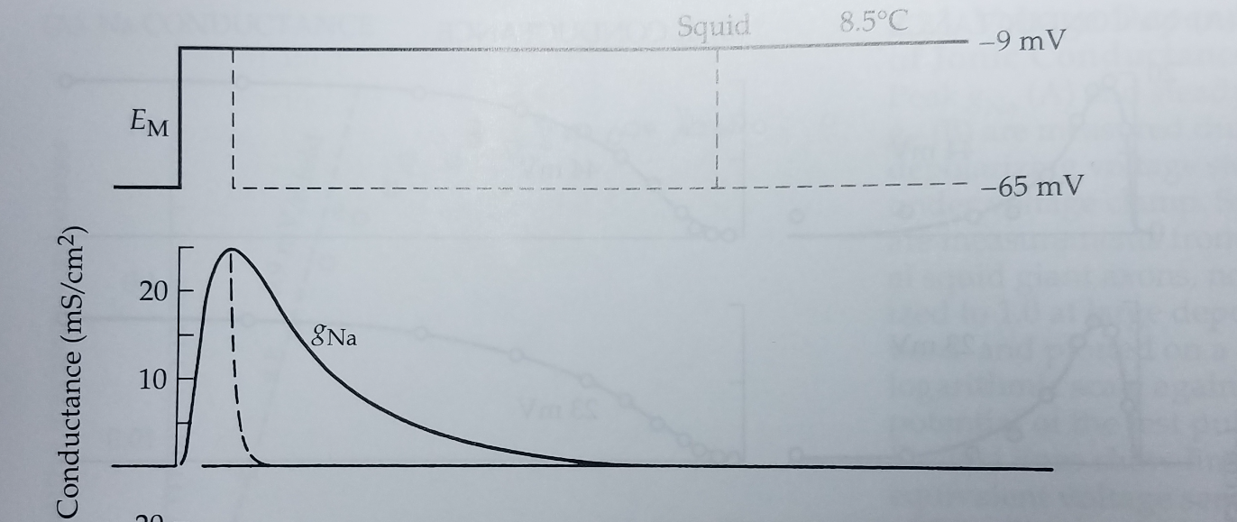
First of all….is the sodium current ohmic?
(everything is easier if it is)
V=IR
or I=V/R
or R=V/I
or 1/R=I/V
Ohmic!
Express current
in terms of conductance (g)…
g = 1/R
g = I/V
g_{Na} = I_{Na}/(V_{m}-E_{Na})

Slide 21
First of all….is the sodium current ohmic?
(everything is easier if it is)
V=IR
or I=V/R
or R=V/I
or 1/R=I/V
sigmoidal
exponential

Slide 22
Channel Basics
Channel
Gate

Slide 23
Channel Basics
Channel
Gate

Slide 24
First of all….is the sodium current ohmic?
(everything is easier if it is)
V=IR
or I=V/R
or R=V/I
or 1/R=I/V
The Shape Tells
You Something
About Gates!
sigmoidal
exponential

Slide 25
Gate Kinetics
Activation Gate (m)
Inactivation Gate (h)
Sodium
Channel
inside
outside

Slide 26
Gate Kinetics
open
closed

Slide 27
Gate Kinetics
open
closed

Slide 28
Gate Kinetics
transition rate
constants
open
α
β
In reality…
α & β constants = # of times per second
a gate changes
closed
What is the proportion of gates that are open?
At Equilibrium?
What is the proportion of gates that are closed?
α (1-P)
β P
Proportion that are open
Proportion that are closed
=
P
1-P
α
Fraction that are opening
Fraction that are closing
P =
α + β
α (1-P)
β P

Slide 29
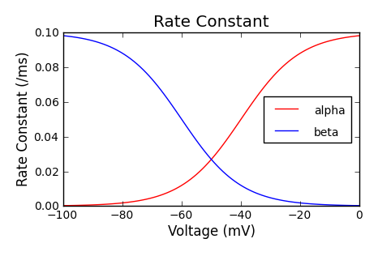
Gate Kinetics
transition rate
constants
open
α
β
In reality…
α & β constants = # of times per second
a gate changes
closed
At Equilibrium?
α (1-P)
β P
=
α
P =
α + β

Slide 30
Gate Kinetics
transition rate
constants
open
α
β
In reality…
α & β constants = # of times per second
a gate changes
closed
V₂
At Equilibrium?
P₂
P₂
α (1-P)
β P
V₁
=
P₁
P₂
α
τ₁
τ₂
P =
1
α + β
P₁
=
τ₂
α + β
V₁
V₂

Slide 31
Gate Kinetics
transition rate
constants
open
α
β
In reality…
α & β constants = # of times per second
a gate changes
closed
It takes time to reach P
V₂
At Equilibrium?
P₂
P₂
α (1-P)
β P
V₁
=
P₁
P₂
α
τ₁
τ₂
P =
1
α + β
P₁
=
τ₂
α + β
V₁
V₂

Slide 32
Sodium Channel Opening
+
-
-
+
-
+
Activation Gate (m)
Inactivation Gate (h)
1
Sodium
Channel
+
-
0
+
inside
-
outside
+
-
1
0

Slide 33
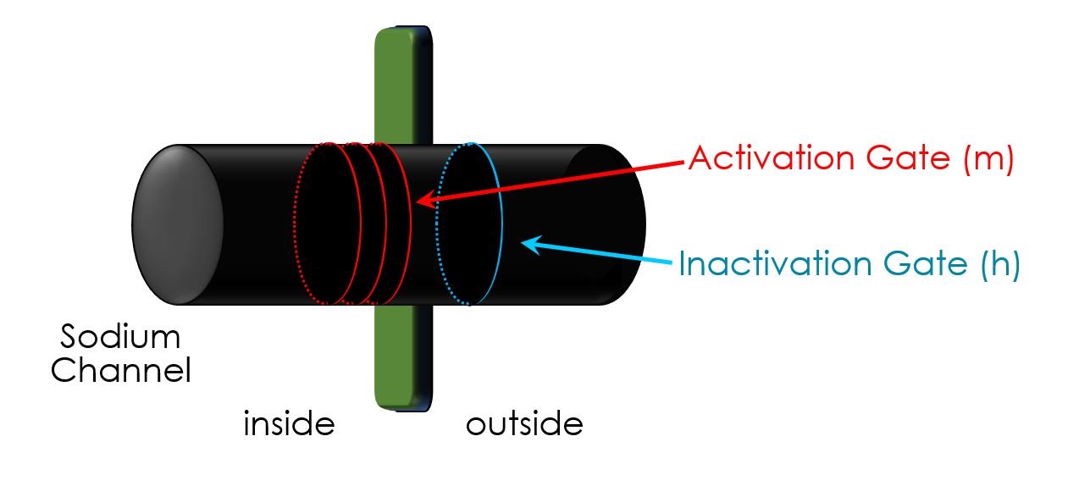
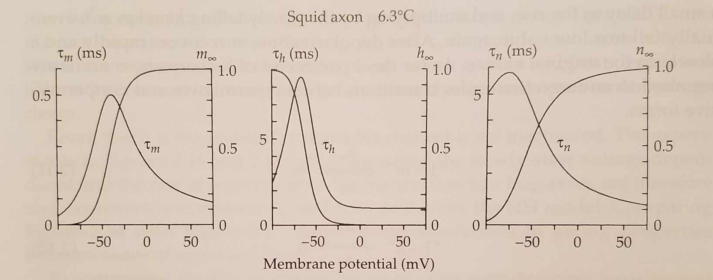
Sodium Channel Opening
α
m
α
h
m =
h =
α + β
α + β
m
m
h
h
1
1
τ
m
τ
h
=
=
α + β
α + β
m
m
h
h
At Equilibrium?
α
P =
α + β
1
τ
=
α + β

Slide 34
Sodium Channel Opening
inside
outside
+
-70mV
+
-
+
-
+
-
-
+
Activation Gate (m)
-30mV
time
+
-
Inactivation Gate (h)
+
Sodium
Channel
+
-
+
-
-30mV
+
-
inside
outside
+
-30mV

Slide 35
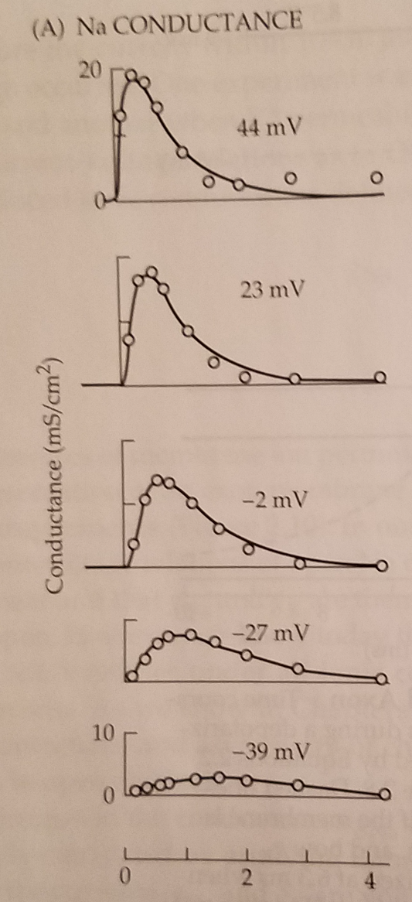
Sodium Channel Opening
inside
outside
+
α
m
α
h
-70mV
m =
h =
+
α + β
α + β
-
m
m
h
h
+
1
1
τ
m
τ
h
=
=
-30mV
α + β
α + β
m
m
h
h
time
+
-
+
At Equilibrium?
α
-30mV
P =
α + β
+
1
τ
=
α + β
-30mV

Slide 36
Channel Opening
Sodium
Channel
Potassium
Channel

Slide 37
The end

